Slide 1


AGRO IRRIGO
WELCOME TO THE SMART GENERATION OF IRRIGATION
TEAM AimDuo
MOHAMED AKHEEL.M
MOHAMED IBRAHIM
HackOFiesta-Flagship Hackathon of India
01

Slide 2
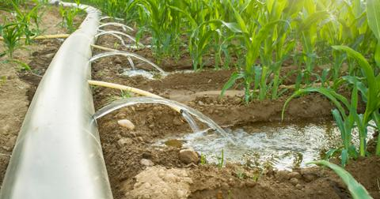
PROBLEM STATEMENT
At recent times farmers find it difficult to irrigate the fields due to lack of availability of water.
One of the main reason for this is overuse of water for irrigating the fields without proper calculation and proper mechanism to use the required amount of water.
We bring in a technology through which the farmers could control the discharge of water exactly.

Slide 3

PROPOSED SOLUTION
We propose a solution through which the farmers could exactly control the volume of water discharges through the pipes.
We have adopted this technology for Drip irrigation as it is one of the effective means of irrigation practices in India where less amount of water is required for irrigating the fields.
Our equipment has a pipe with precalculated holes in it, which are initially closed using a slider.
Water is passed through the holes by a conventional pump.
As the water passes, pressure is built up in the tube (as water is blocked at the other side of the tube).
When the slider is opened, due to this excess pressure in the tube water I sprinkled to the field through the tubes in equal amount.
Also we have provided an another mechanism by which the farmers could generate electricity with this pressure when irrigation doesn’t take place.

Slide 4

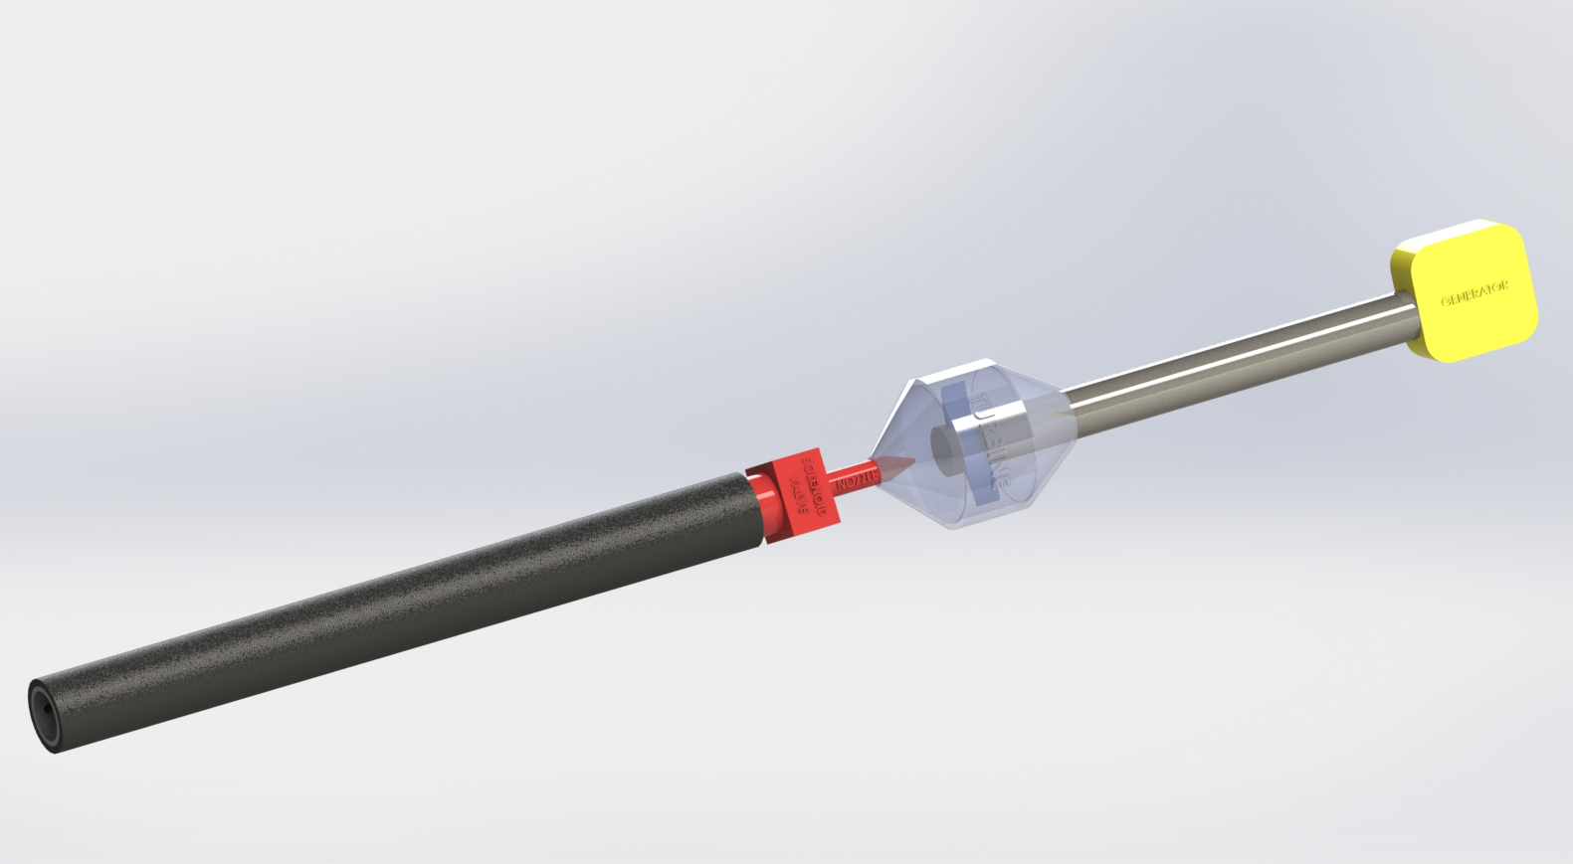
UNIQUE SELLING POINTS
1.
Could save water for irrigation in an effective way.
2.
Will reduce the cost of electricity generation, as power is developed with the pressure in thee tubes.
3.
Crops will grow effectively as amount of water needed by it is exactly given to it.

Slide 5

YOUR TECH STACK
1.
SOLIDWORKS
The mechanical model is developed using the software SolidWorks. Also the simulation of the model is performed there.
2.
ANDROID STUDIO
The app used to control the flow of water on our equipment is built using JAVA programming in Android Studio.

Slide 6
THANK YOU
Feel free to add more slides!

